Slide 1

Retail Sales Analysis
Comprehensive SQL-driven insights on transaction data, customer behavior, and operational patterns

Slide 2

Project Scope
10K+
1.5K+
3
Transactions
Unique Customers
Major Categories
Multi-year dataset analyzed
Cross-category analysis
Diverse customer base

Slide 3
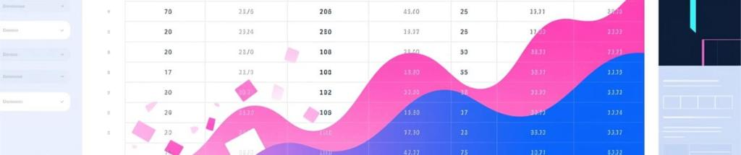
Data Quality Foundation
Methodology
Data Source
SQL-driven exploratory data analysis
retail_db
Diagnostic pattern recognition
Comprehensive transaction records with customer demographics and temporal data
Missing values removed for integrity
Validated data consistency

Slide 4
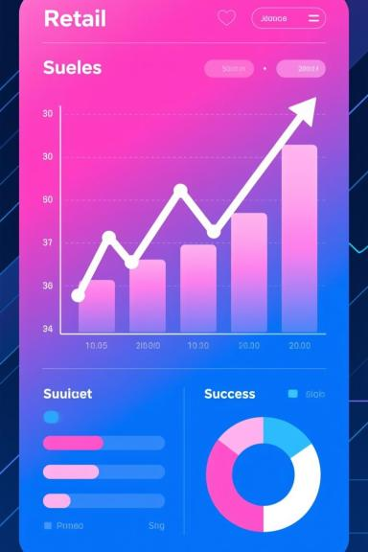
Sales Performance Insights
Category Revenue
High-Value Transactions
Significant dispersion across product categories
Multiple orders exceeding $1,000 identified
Performance Patterns
Clear monthly ranking variations

Slide 5


Customer Behavior Analysis
5
100%
Top Contributors
Demographic Patterns
Top 5 customers drive major revenue share
Clear category preferences by customer segments

Slide 6

Temporal Patterns Discovered
1
Monthly Performance
Window functions reveal ranking shifts
2
Time-of-Day Impact
Order volume varies by hour
3
Seasonal Trends
Multi-year patterns identified

Slide 7

SQL Techniques Applied
1
Aggregations
SUM, COUNT, AVG for performance metrics
2
Window Functions
RANK, PARTITION BY for comparative analysis
3
Date Functions
EXTRACT, TO_CHAR for temporal insights
4
Data Validation
Cleaning and integrity queries

Slide 8




Business Recommendations
Loyalty Program
Reward top customers driving revenue
Inventory Optimization
Align stock with time-of-day and monthly patterns
Targeted Marketing
Leverage demographic insights for campaigns

Slide 9

Limitations & Future Directions
Current Limitations
Next Steps
No external factors (holidays, weather)
Time-series forecasting models
Missing LTV metrics
Customer clustering analysis
Limited customer journey data
Real-time analytics implementation

Slide 10

Key Takeaways
Data-Driven Insights
Strategic Opportunities
SQL analysis reveals actionable patterns in sales and customer behavior
Clear paths for loyalty programs and inventory optimization
Foundation for Growth
Robust methodology enables advanced analytics and forecasting
Prepared by: Data Analytics Team

